Slide 1
Software Engineering I
Dr. Elham Mahmoudzadeh
Isfahan University of Technology
mahmoudzadeh@iut.ac.ir
2021

Slide 2
Chapter 9 Data Management Layer Design

Slide 3
Steps(I)
Preparing proposal
Requirements determination
User story
Abstract Business Process Modelling
Analysis
Functional Modelling
Structural Modelling
Behavioral Modelling

Slide 4
Steps(II)
Design
Optimization
Database Management
User Interface
Physical Architecture

Slide 5
Introduction
Applications are of little use without the data that they support.
The data storage component manages how data are stored and handled by the programs that run the system.
The data storage component is composed of a set of object persistence classes.

Slide 6
Object Persistence Formats
A database is a collection of groupings of information, each of which is related to each other in some way (e.g., through common fields).
A database management system (DBMS) is software that creates and manipulates these databases.
Sequential and Random Access Files
Relational Databases
Object-Relational Databases
Object-Oriented Databases
NoSQL Data Stores

Slide 7
Sequential and Random Access Files
Sequential access files allow only sequential file operations to be performed.
Random access files allow only random or direct file operations to be performed.
Master files store core information that is important.
Lookup files contain static values.
A transaction file holds information that can be used to update a master file.
The history file (or archive file) stores past transactions that are no longer needed by system users.

Slide 8
Relational Databases
Is the most popular kind of database for application development today.
A relational database is based on collections of tables with each table having a primary key—a field or fields whose values are unique for every row of the table.
The tables are related to one another by placing the primary key from one table into the related table as a foreign key.
Most relational database management systems (RDBMS) support referential integrity, or the idea of ensuring that values linking the tables together through the primary and foreign keys are valid and correctly synchronized.

Slide 9
Object-Relational Databases
Object-relational database management systems (ORDBMSs) are relational database management systems with extensions to handle the storage of objects in the relational table structure. This is typically done through the use of user-defined types. For example, an attribute in a table could have a data type of map, which would support storing a map.

Slide 10
Object-Oriented Databases
With an OODBMS, collections of objects are associated with an extent.
An extent is simply the set of instances associated with a particular class (i.e., it is the equivalent of a table in a RDBMS).
Each instance of a class has a unique identifier assigned to it by the OODBMS: the Object ID.
From a practical point of view, it is still a good idea to have a semantically meaningful primary key.

Slide 11
NoSQL Data Stores
Most NoSQL data stores were created to address problems associated with storing large amounts of distributed data in RDBMSs.
NoSQL data stores tend to support very fast queries.
When it comes to updating, NoSQL data stores normally do not support a locking mechanism, and consequently, all copies of a piece of data are not required to be consistent at all times. So it is technically possible to have different values for different copies of the same object stored in different locations in a distributed system.

Slide 12
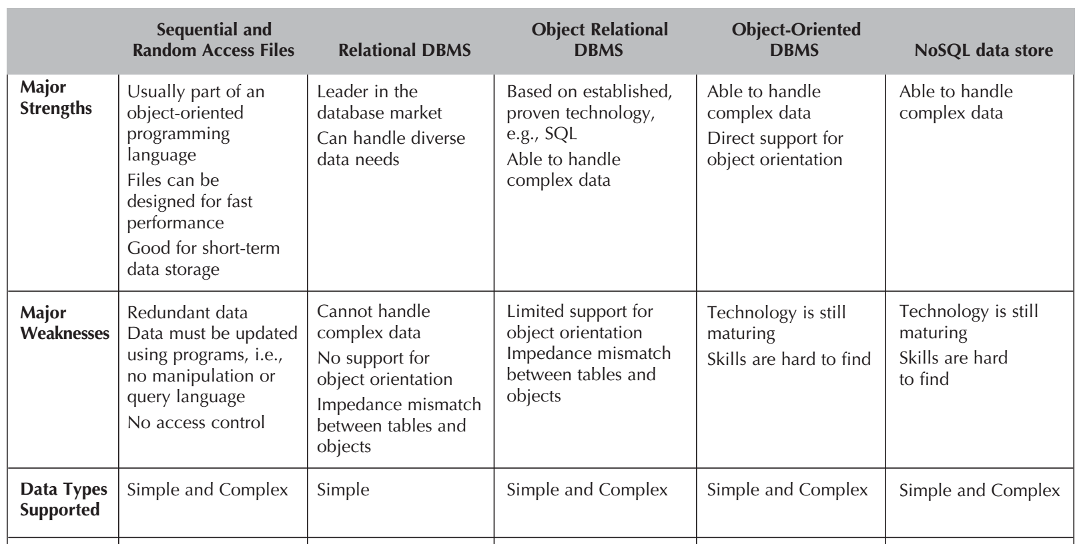
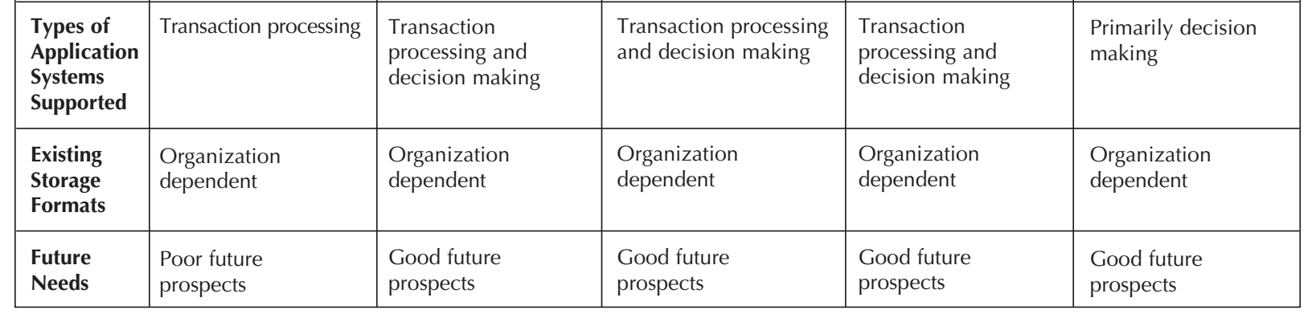
Selecting an Object Persistence Format

Slide 13
Nonfunctional Requirements and Data Management Layer Design
Operational requirements
Issues that deal with the technology being used to support object persistence. However, the choice of the hardware and operating system limits the choice of the technology and format of the object persistence available.
Performance requirements
Speed and capacity
Security requirements
Access controls, encryption, and backup.
Political and cultural requirements
Include expected number of characters that should be allocated for a data field, the format of a data field.

Slide 14
Reference
Dennis, Wixon, Tegarden, “System Analysis and Design, An Object Oriented Approach with UML”, 5th Edition, 2015.

